Slide 1
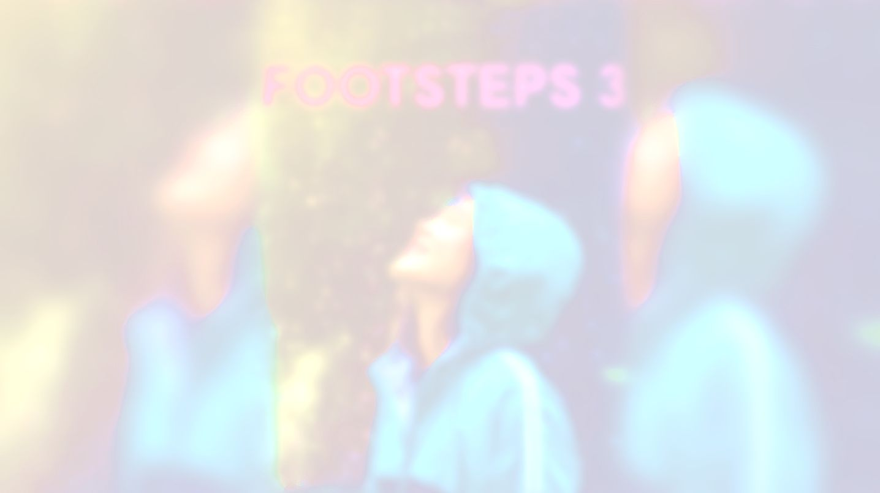
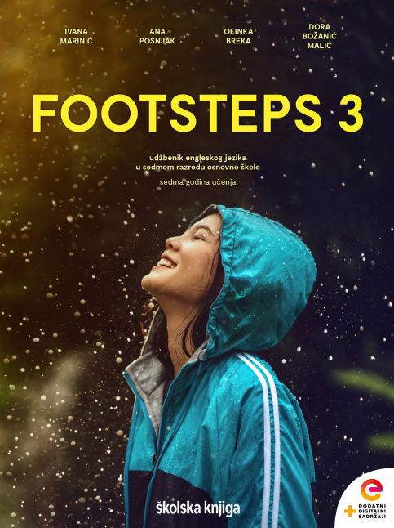

UNIT 7; Which way to go?
Making plans

Slide 2
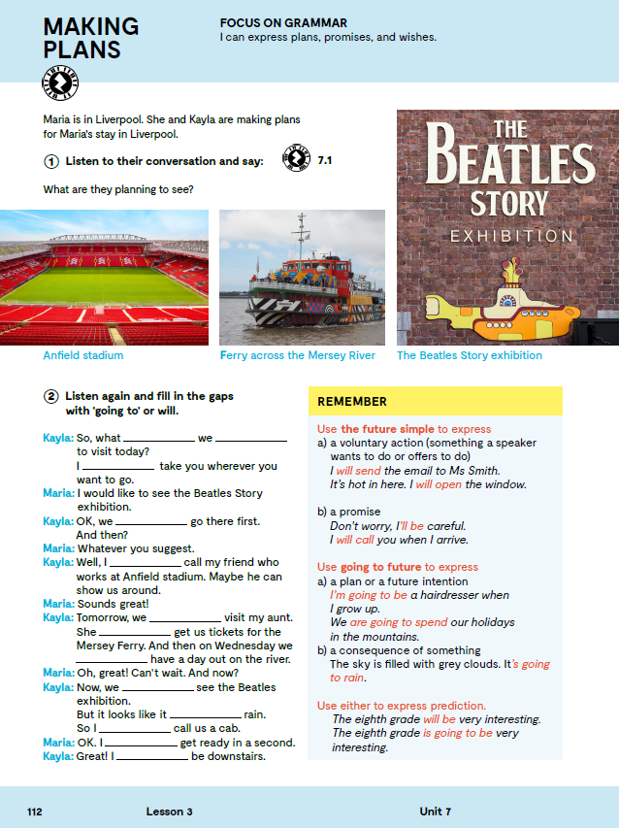

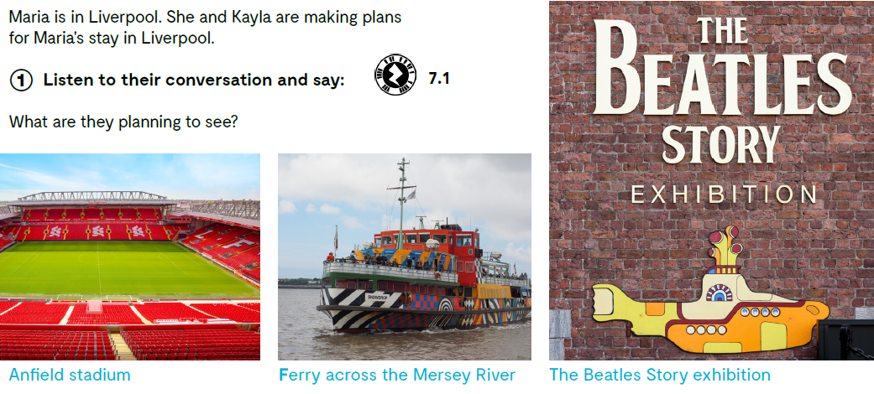
Maria is in Liverpool. She and Kayla are making plans for Maria's stay in Liverpool. Listen to their conversation and say: What are they planning to see?
Where are you going to spend your summer holidays?
Where are you going to stay?
What are you going to see/ visit there?
Who is going to go with you?
Are you maybe going to go alone?
How are you going to get there?

Slide 3
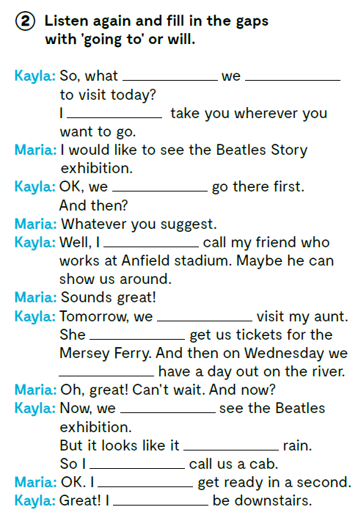

are going
will
will
am going to
are going to
is going to
are going to
are going to
is going to
will
will
will

Slide 4
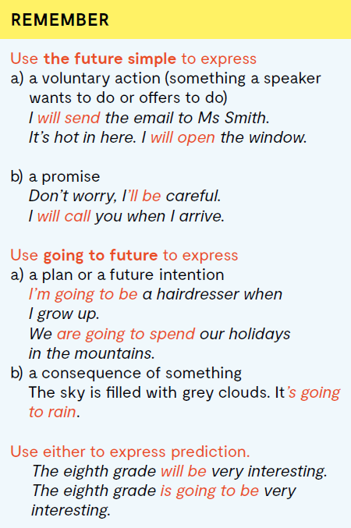
Future Simple (WILL + glagol) koristimo kako bismo izrazili:
dobrovoljnu radnju (nešto što govornik želi napraviti ili se nudi da napravi)
Obećanje
Going to oblik (am/is/are + going to + glagol) koristimo kada želimo izraziti:
plan ili namjeru za budućnost
posljedicu nečega
Bilo koji od oblika možemo koristiti kako bismo izrazili predviđanje.

Slide 5
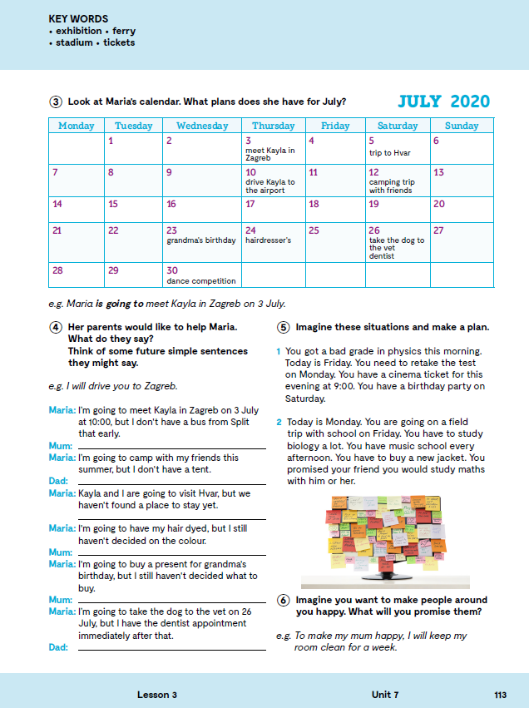
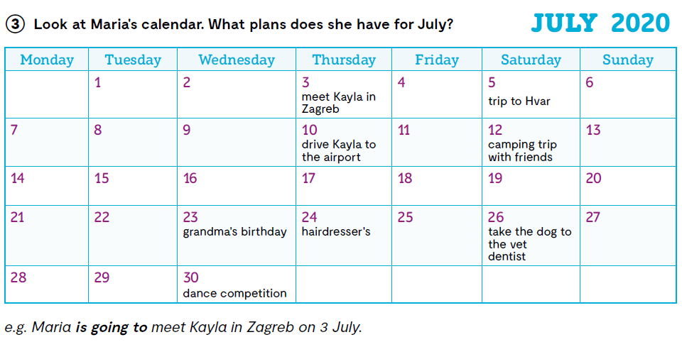

Slide 6
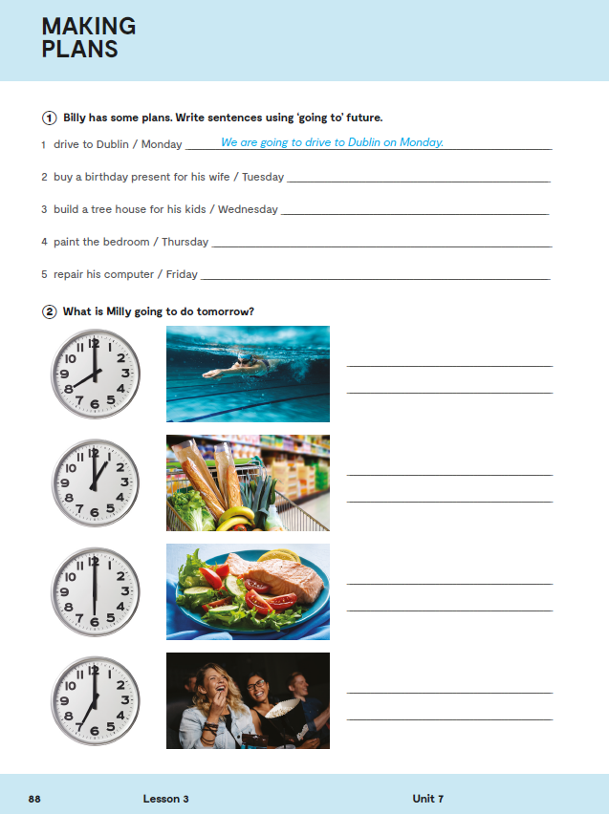
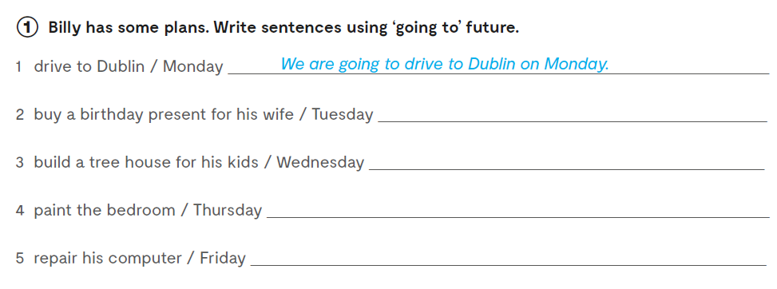
Workbook, p. 88
He is going to buy a birthday present for his wife on Tuesday.
He is going to build a tree house for his kids on Wednesday.
He is going to paint the bedroom on Thursday.
He is going to repair his computer on Friday.

Slide 7
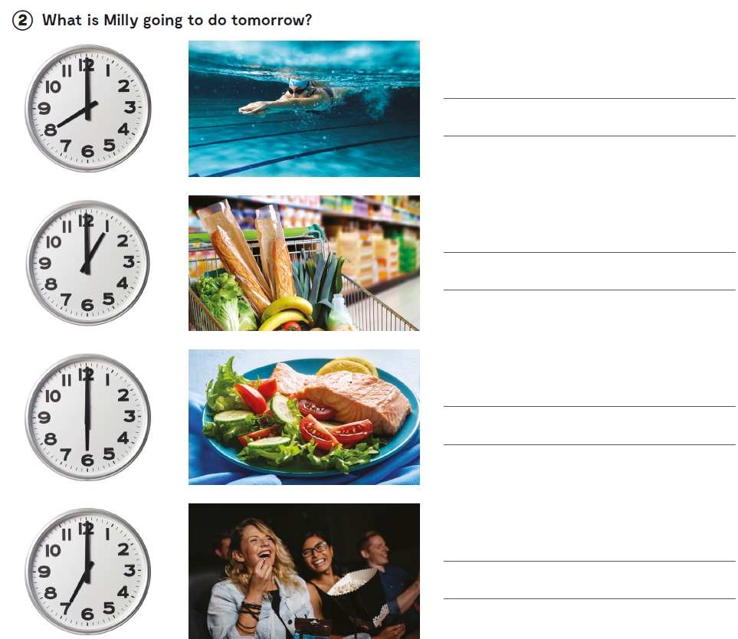
Milly is going to swim at 8 am.
Let’s practise: https://learningapps.org/watch?v=p13z8b53a20
She is going to buy groceries/go shopping at 1 pm.
She is going to have dinner at 6 pm.
She is going to go to the cinema at 7 pm.

Slide 8

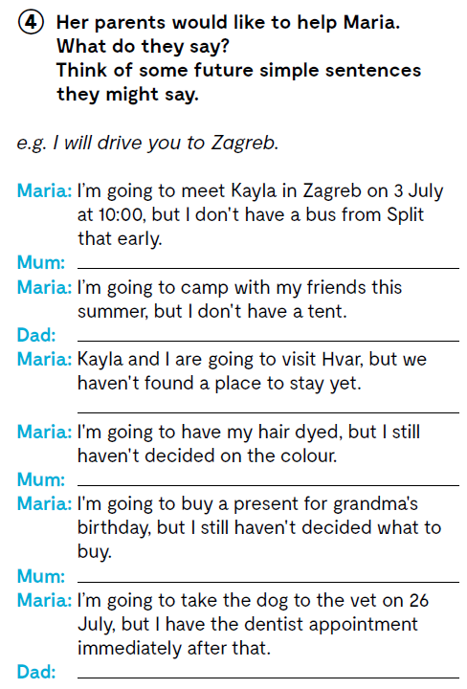
I will buy you a tent.
...

Slide 9

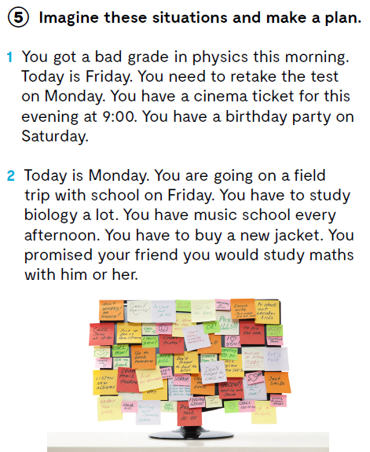
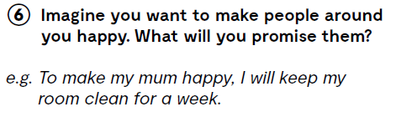

Slide 10
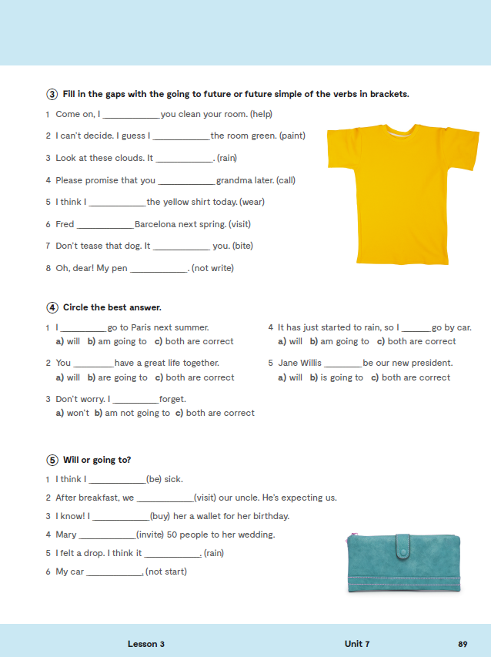
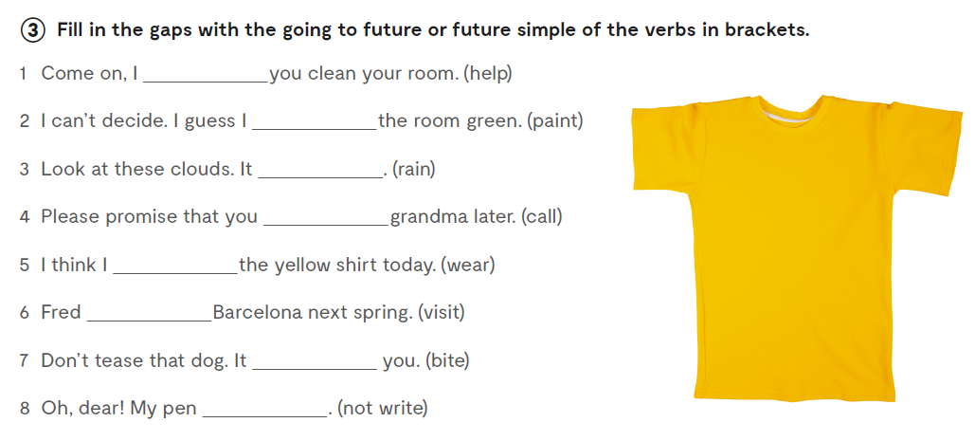
Workbook, p. 89
will help
will paint
is going to rain
will call
will wear
is going to visit
is going to bite
will not write

Slide 11
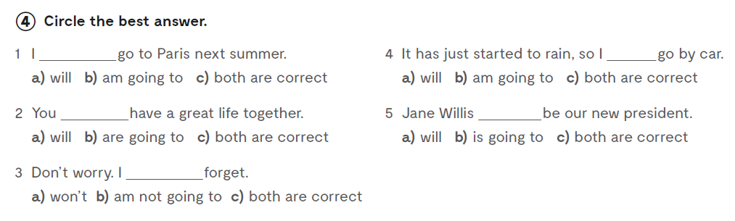


Slide 12
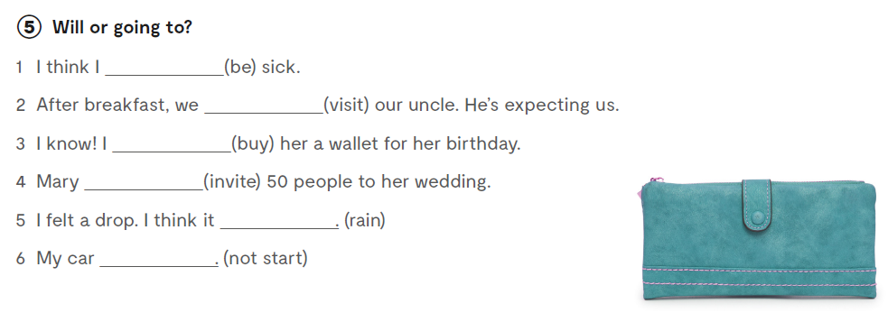
am going to be
are going to visit
will buy
is going to invite
is going to rain
won’t start

Slide 13

LEARN MORE
https://www.e-sfera.hr/dodatni-digitalni-sadrzaji/4909386f-a5cf-4ecc-b156-81b91c4d30ce/
7 time-management tips

